Slide 1


Accuracy Metrics in Machine Learning: Types and Examples
This presentation explores essential evaluation metrics in machine learning. Understanding these metrics is crucial for effective model assessment. We will cover various types and their applications.
by abinash panta

Slide 2




Why Do Metrics Matter?
Model Selection
Performance Insight
Metrics guide choosing the best model for a task.
They reveal how well a model is actually performing.
Task Alignment
Different metrics suit classification vs. regression tasks.
Metrics are vital for both selecting and continuously improving machine learning models. The choice of metric depends heavily on the specific machine learning task.

Slide 3
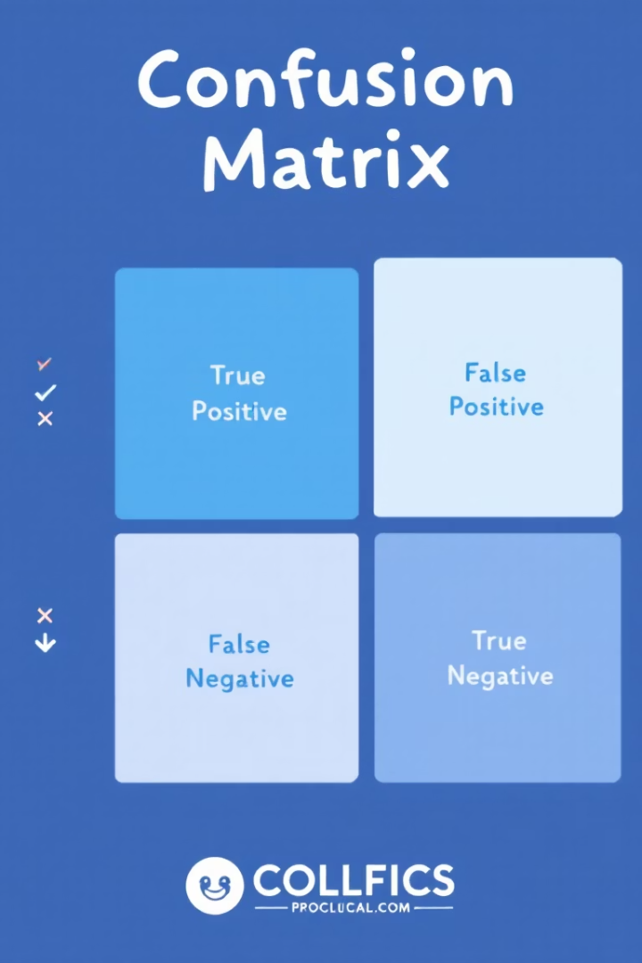
Confusion Matrix: Foundation for Classification Metrics
Actual Spam (20)
Predicted Spam
Predicted Non-Spam
True Positive (TP)
15 (correctly spam)
5 (missed spam)
Actual Non-Spam (80)
5 (false alarm)
75 (correctly non-spam)
A 2x2 table, the confusion matrix, is fundamental for binary classification. It organizes predictions into True Positives, False Positives, True Negatives, and False Negatives. For example, consider 100 emails: 80 non-spam and 20 spam.

Slide 4

Accuracy: The Basic Metric
85%
70
Email Prediction Accuracy
Non-Spam Correct
Overall correct predictions on 100 emails.
Emails correctly identified as non-spam.
15
Spam Correct
Emails correctly identified as spam.
Accuracy measures the proportion of correctly classified instances: (TP + TN) / Total. For example, 85% accuracy on 100 emails (70 non-spam, 15 spam predicted right). It is best used when classes are well-balanced.

Slide 5




Precision: Focus on Positive Predictions
18 Emails Tagged Spam
Total emails the filter marked as spam.
15 Really Spam
Number of actual spam emails among those marked.
Precision ≈ 83%
15 true spam out of 18 predicted spam.
Precision calculates TP / (TP + FP). It evaluates the accuracy of positive predictions. A spam filter marking 18 emails as spam, with 15 being true spam, yields ~83% precision. This metric is crucial when false positives are costly, such as in medical diagnoses.

Slide 6
Recall (Sensitivity): Identifying True Positives
Total Actual Spam
Detected Spam
Recall Calculation
20 emails were genuinely spam.
15 of these 20 were correctly identified.
15 True Positives / 20 Actual Positives = 75%.
Recall, also known as sensitivity, is TP / (TP + FN). It measures the ability to find all relevant instances. If 15 out of 20 real spam emails are detected, recall is 75%. This metric is critical when missing positives carries high risk, such as in cancer screening.

Slide 7

F1 Score: Balancing Precision and Recall
Precision: 83%
Recall: 75%
Accuracy of positive predictions.
Ability to identify all true positives.
F1 Score: ~78.8%
Harmonic mean of precision and recall.
The F1 Score is the harmonic mean of Precision and Recall: 2 × (Precision × Recall) / (Precision + Recall). With 83% precision and 75% recall, the F1 score is approximately 78.8%. This metric is particularly useful when dealing with imbalanced datasets, offering a balanced view of model performance.

Slide 8




Specificity, ROC Curve, and AUC
Specificity
TN / (TN + FP) measures true negatives.
ROC Curve
Plots True Positive Rate vs. False Positive Rate.
AUC
Area Under the ROC Curve; higher AUC implies better model. It represents the probability that the classifier will rank a randomly chosen positive instance higher than a randomly chosen negative instance.
Specificity focuses on how well a model identifies true negatives. The ROC Curve visualizes classifier performance across all thresholds, plotting the True Positive Rate against the False Positive Rate. The Area Under the Curve (AUC) quantifies the overall performance of the classifier; a higher AUC indicates a better model.

Slide 9






Regression Metrics: MAE & RMSE
RMSE (Root Mean Squared Error)
Square root of mean squared errors. Penalizes larger errors more severely.
MAE (Mean Absolute Error)
Average of absolute errors. It's robust to outliers.
Use Cases
Ideal for continuous target variables, like predicting house prices.
For continuous target variables, such as house price prediction, Mean Absolute Error (MAE) and Root Mean Squared Error (RMSE) are key. MAE calculates the average of absolute errors, making it robust to outliers. RMSE, however, penalizes larger errors more, as it squares the errors before averaging.

Slide 10

Conclusion: Choosing the Right Metric
Context is Key
No single metric is universally best; it depends on the problem and business goals.
Holistic View
Combine multiple metrics for a complete understanding of model performance.
Align Goals
Ensure metric choice aligns with project objectives and class balance considerations.
The selection of the right metric is highly dependent on the specific problem and its business context. It's crucial to combine various metrics to gain a comprehensive understanding of model performance. Ultimately, your metric choice must align with your project goals and the balance of your dataset's classes.

